Slide 1
Architecture Patterns in Angular
Why and how?
Ivan Tsymbal, Senior Engineer

Slide 2
Disclaimer
The architecture explained here is a suggestion which means it doesn’t have to fulfill your needs but it can help you structure your own project. It provides guidelines and suggestions to decouple certain parts of your application in order to make it more flexible and maintainable. It’s not a strong set of rules because every type of application requires it’s own architecture to consider.

Slide 3

Why did I decide to talk about Architecture?

Slide 4

History from life: “Big migration”

Slide 5
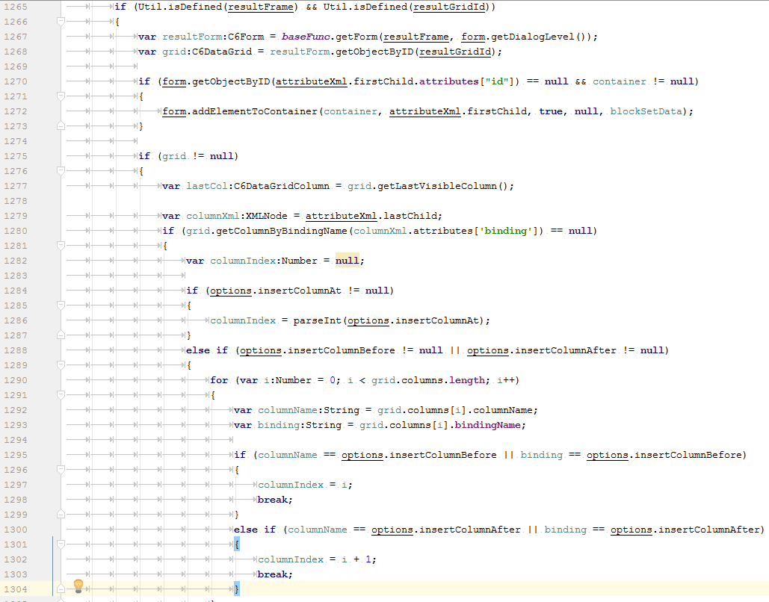
Code example

Slide 6


Slide 7

Dynamic changes from customer

Slide 8

Dynamic changes from customer

Slide 9

Your feelings

Slide 10

What is it?
Architecture
“… decisions
that are hard
to change …”
- Martin Fowler

Slide 11
Main ideas
Flexible
Scalable
Clear
Abstract

Slide 12
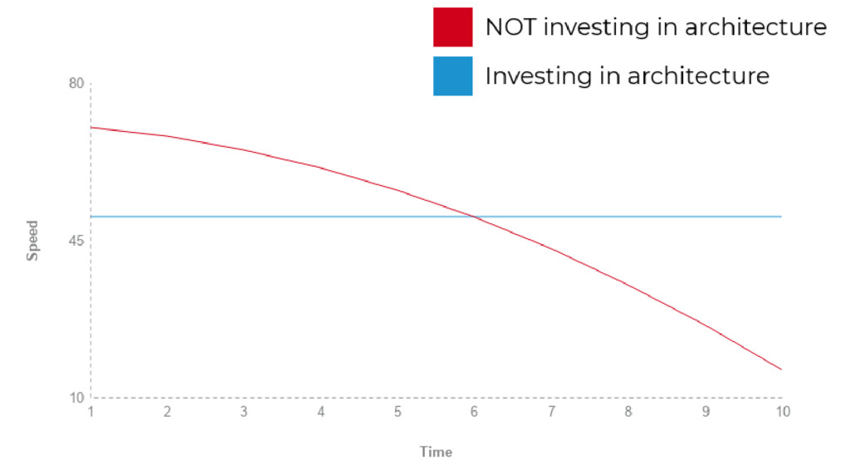
Real situation
Graphic about development?

Slide 13
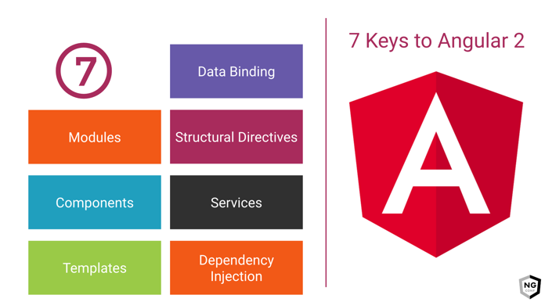
Base of Angular

Slide 14

Developer Wars - App example
https://github.com/Poccomaxazt/angular-architecture-meetup

Slide 15
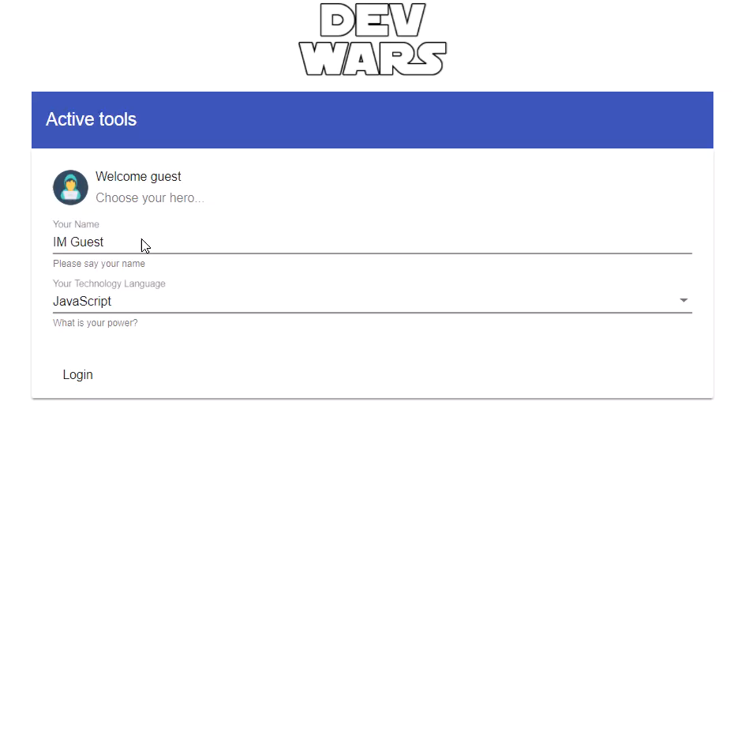

Slide 16
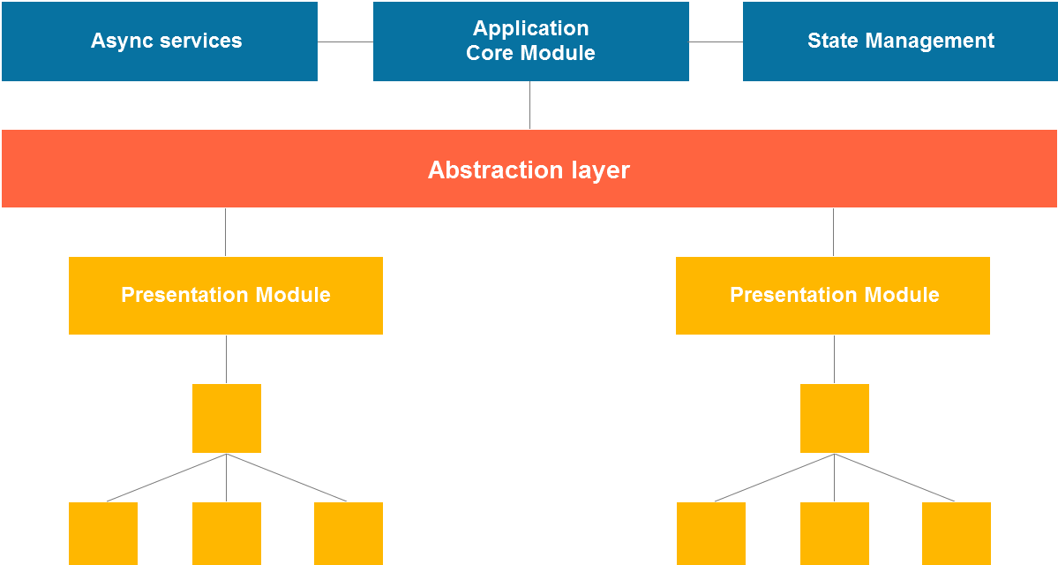
Application layers (high level arc.)

Slide 17
Properties
Modular design
Unidirectional data flow
Predictable state management
Communication layer for async requests
Decoupled presentational layer from core layer

Slide 18
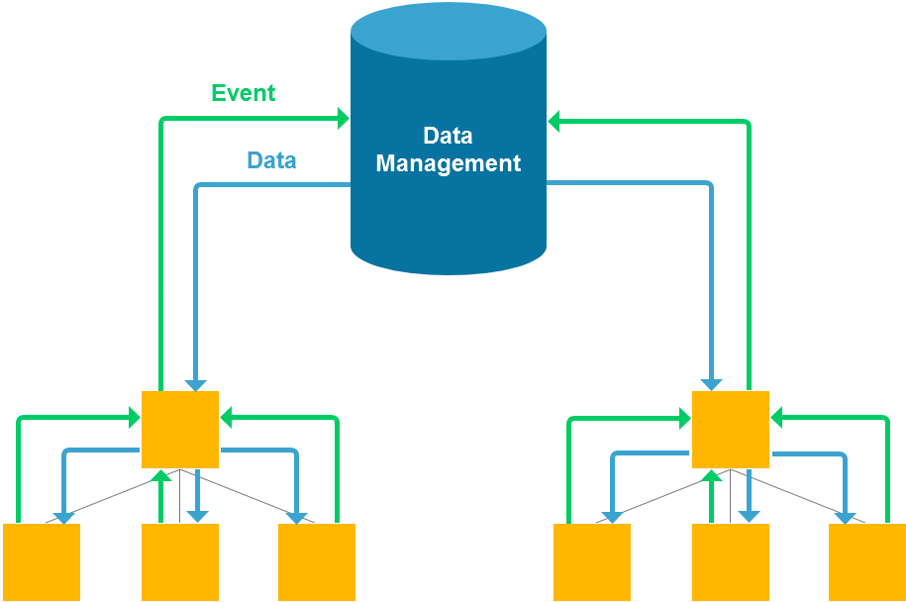
Unidirectional data flow

Slide 19
Importance of tests
arr.forEach(object => object.callMethod())
_.forEach(arr, object => object.callMethod())

Slide 20

GOF patterns
Creational
Structural
Behavioral

Slide 21
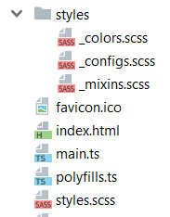
Styles architecture & encapsulation

Slide 22
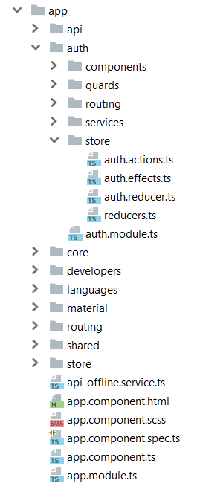
Folders structure

Slide 23
Communication layer for async requests
Application
Remote Service

Slide 24

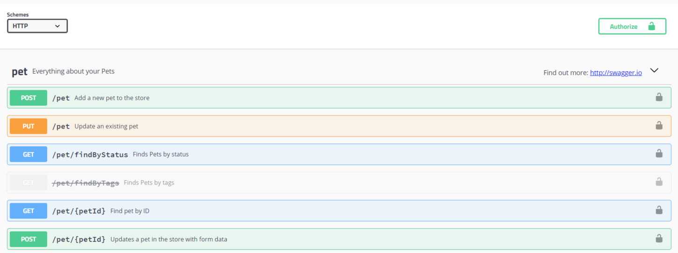
API generation: communication & actualization
https://swagger.io

Slide 25
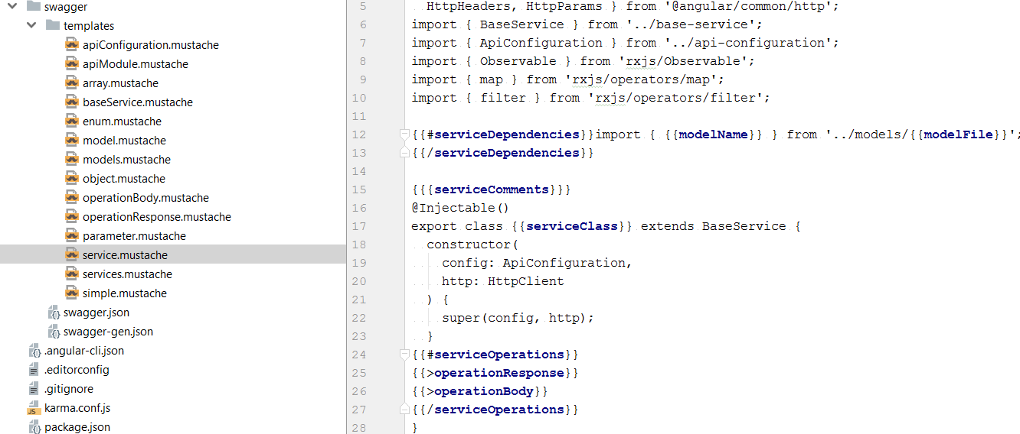
API generation: communication & actualization

Slide 26
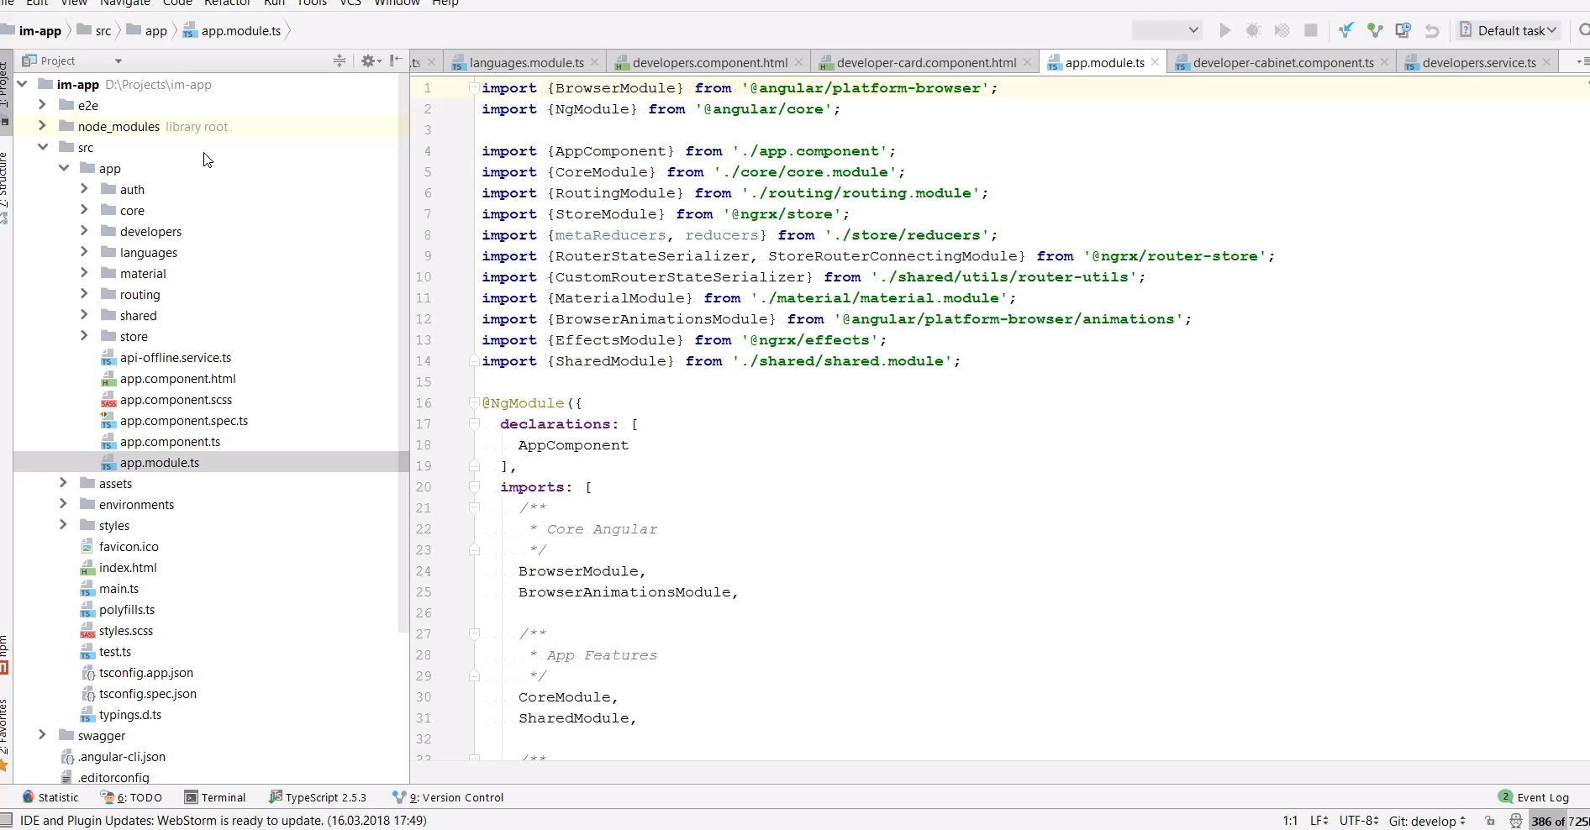
API generation: communication & actualization

Slide 27

State management (combination)
Redux
NgRX
Effects
forFeature
Redux
Redux observable
Epic
Slice

Slide 28
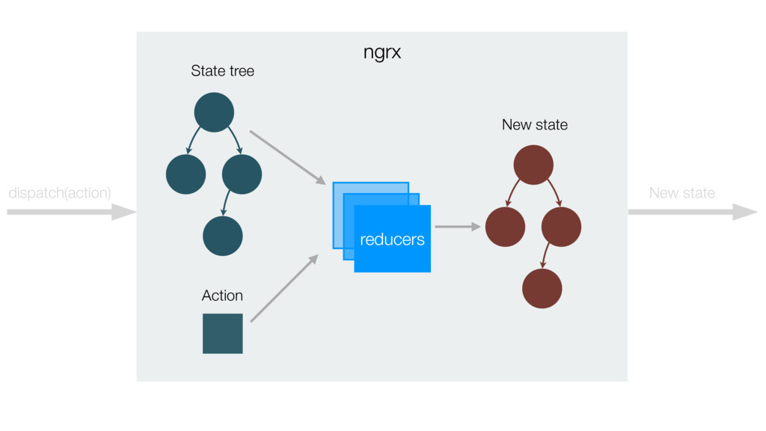
State management (flow)

Slide 29
State management (flow)
request
to server
Async Auth Request
Side Effect
Success
Error
reaction
on login action
dispatch (action)
success login
dispatch (action)
failure login
Login Form
Reducer
State
Component
dispatch (action)
login
apply business
logic
send new state
to subscribers

Slide 30
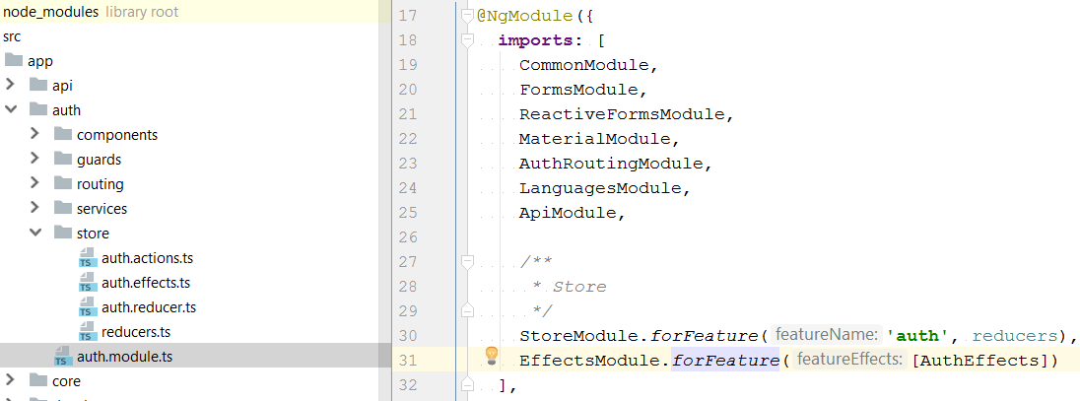
State for features

Slide 31
UI Components
Presentational logic
As stateless as possible
Delegate business logic from view to class and to models

Slide 32
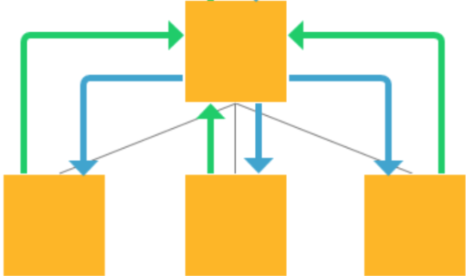
Smart and dump components
DevCabinet
@Output()
commit
@Output()
update
@Input()
config
DevActions
DevCard
DevStatus

Slide 33
Separate presentation & business logic
<div [class.achievements]=“isAchievementsActivated()”>
public isAchievementsActivated(): boolean {
this.developer.commits > 15;
}

Slide 34
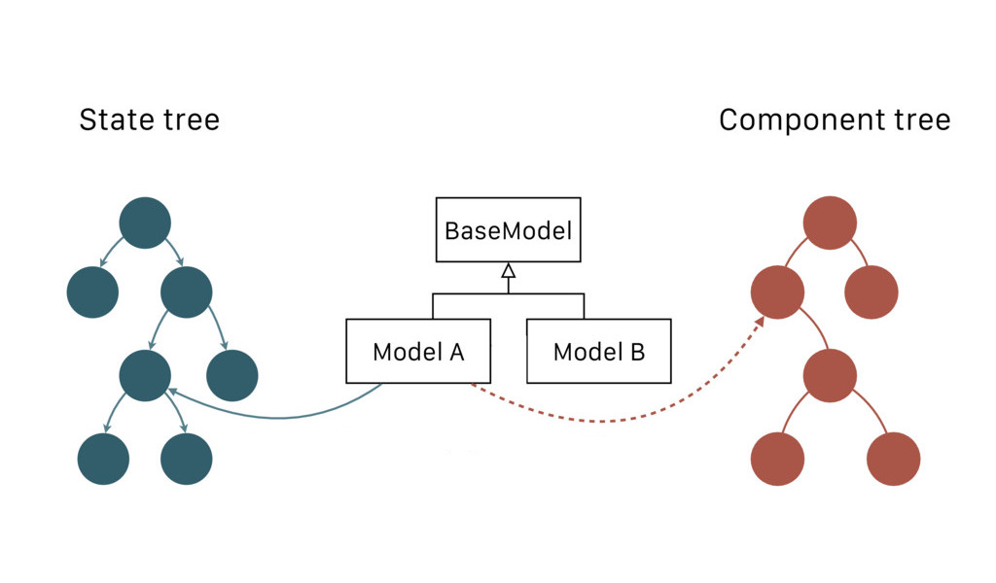
Separate presentation & business logic
Store.select
(fromState.commits)
State stream
(commits$)

Slide 35
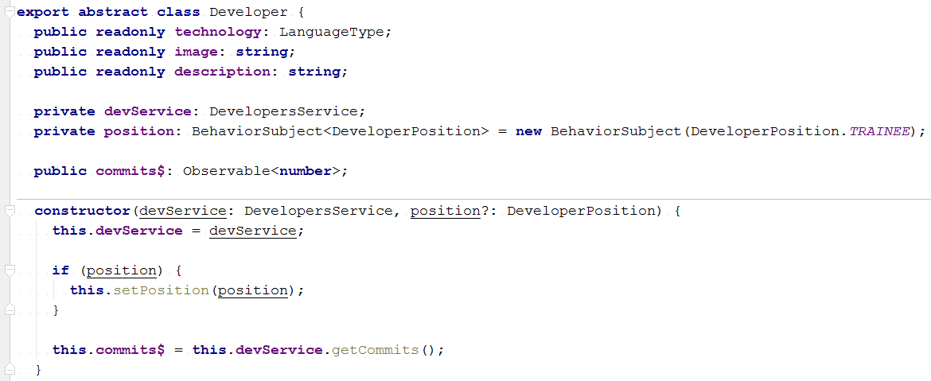
Separate presentation & business logic

Slide 36
Separate presentation & business logic
ngrx
State
state
…
dispatch (action)
addCommit
State – façade - component
State - model
Model
Component
Developer

Slide 37
Separate presentation & rendering logic
“An Attribute directive changes
the appearance or behavior
of a DOM element.”

Slide 38
Decorators
Types
Apply
Class Decorators
Method Decorators
Accessor Decorators
Property Decorators
Parameter Decorators
Decorator Factories
Decorator Composition
Decorator Evaluation
Object Metadata

Slide 39
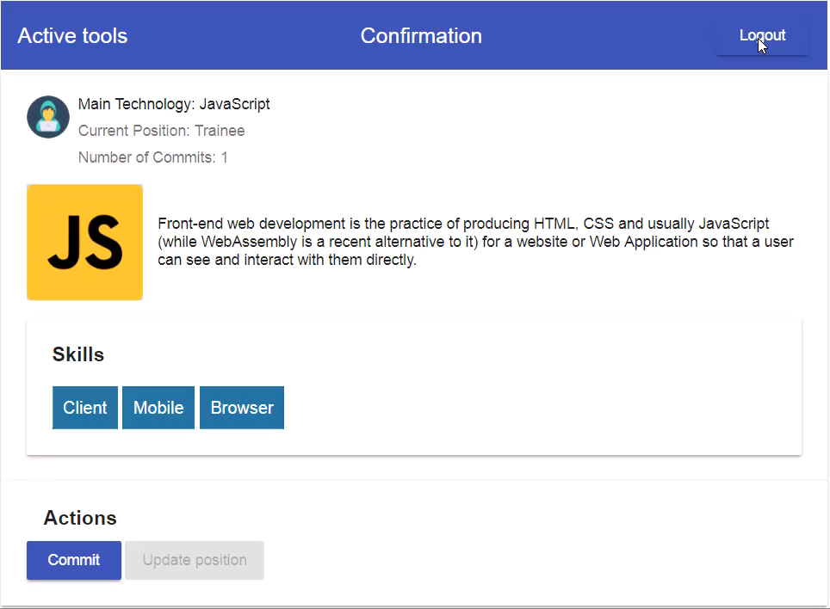
Confirmation

Slide 40
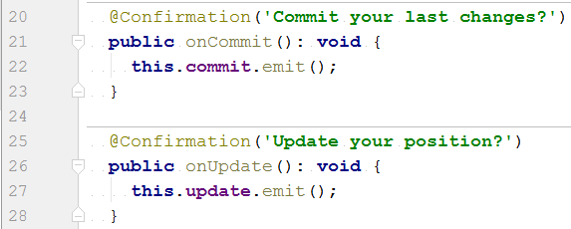
Where to use?

Slide 41
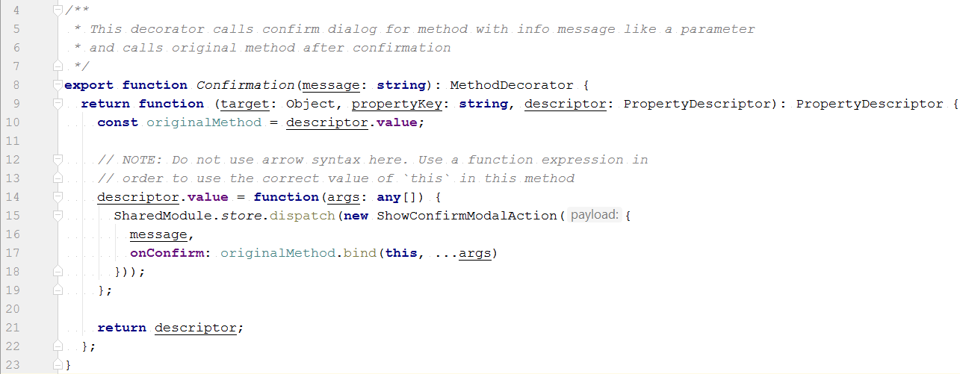
Where to use?

Slide 42

How does it look?

Slide 43

Factory

Slide 44
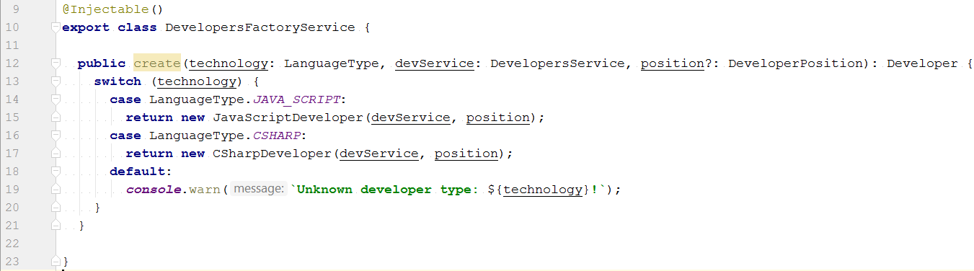
Model type factory

Slide 45
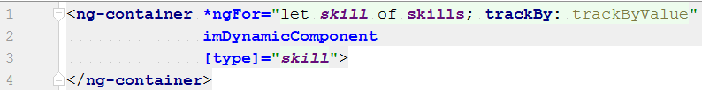
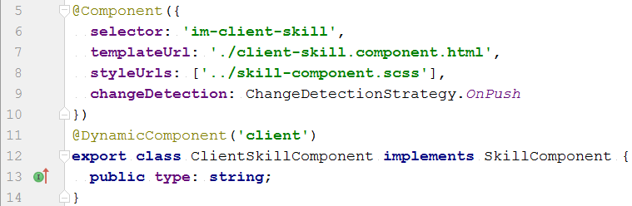
Component factory (+ decorator, + directive)

Slide 46
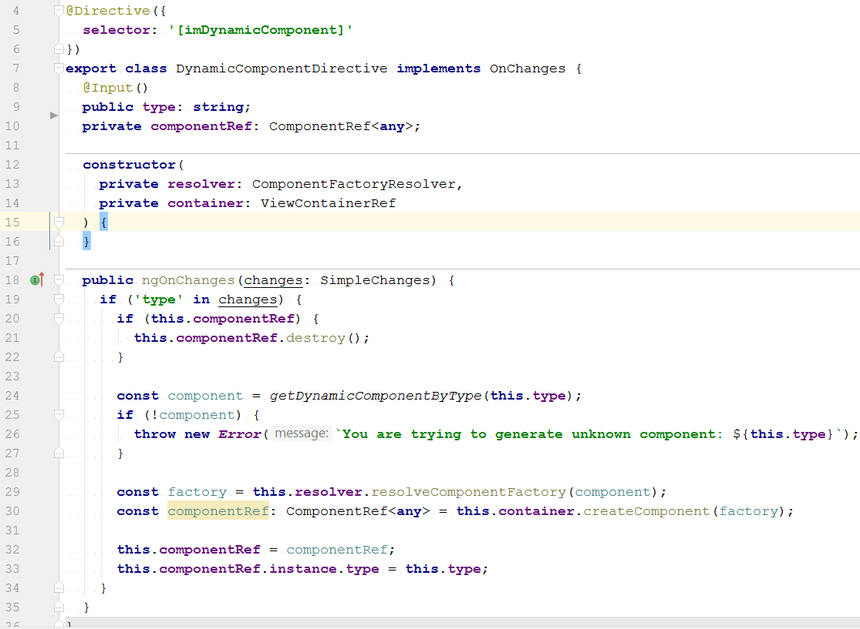
Component Factory (+ decorator, + directive)

Slide 47
Abstraction
Depend on abstractions,
not on concretions.

Slide 48
Abstraction
Languages Socket Service
Stomp Socket Service
Io Socket Service

Slide 49
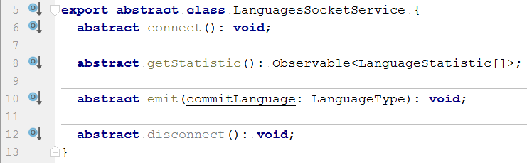
Abstraction

Slide 50
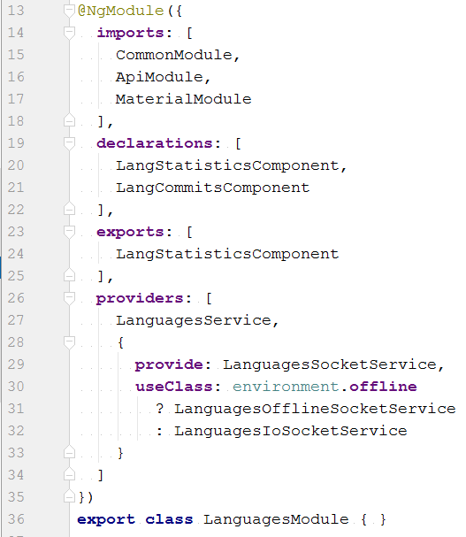
Abstraction

Slide 51
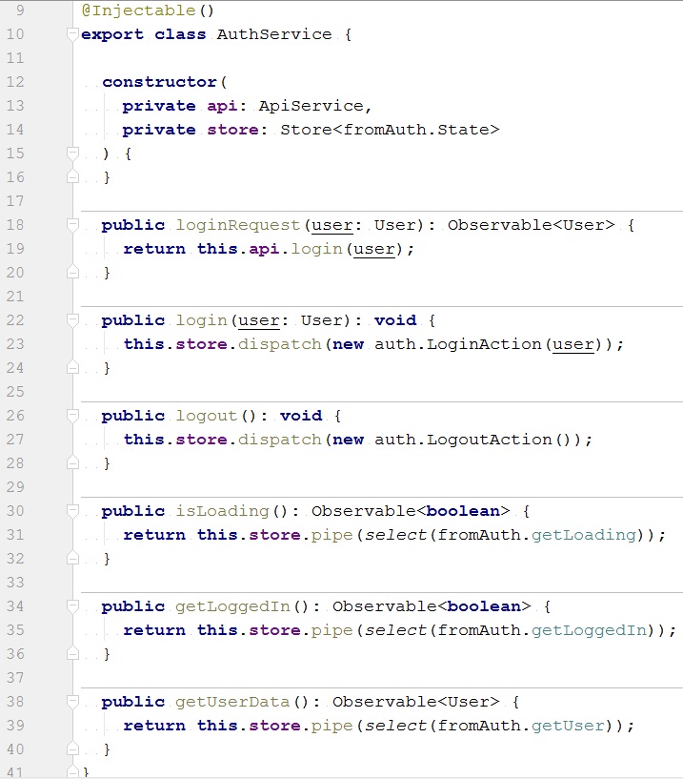
Facade

Slide 52

Observer

Slide 53
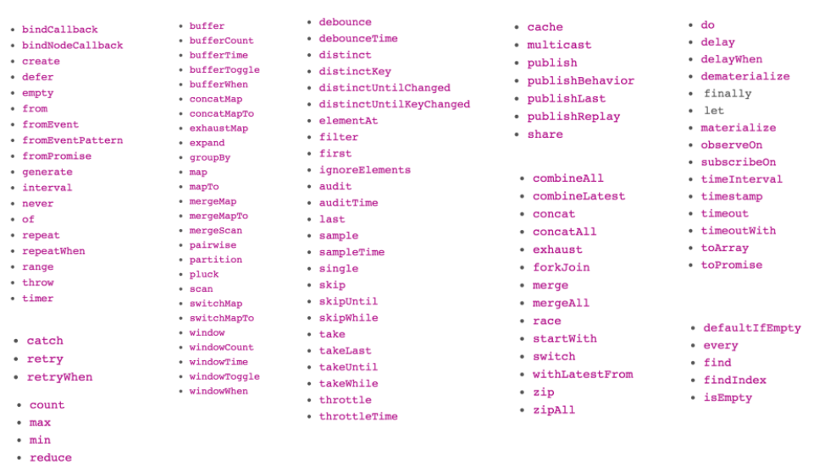
RxJS Operators

Slide 54
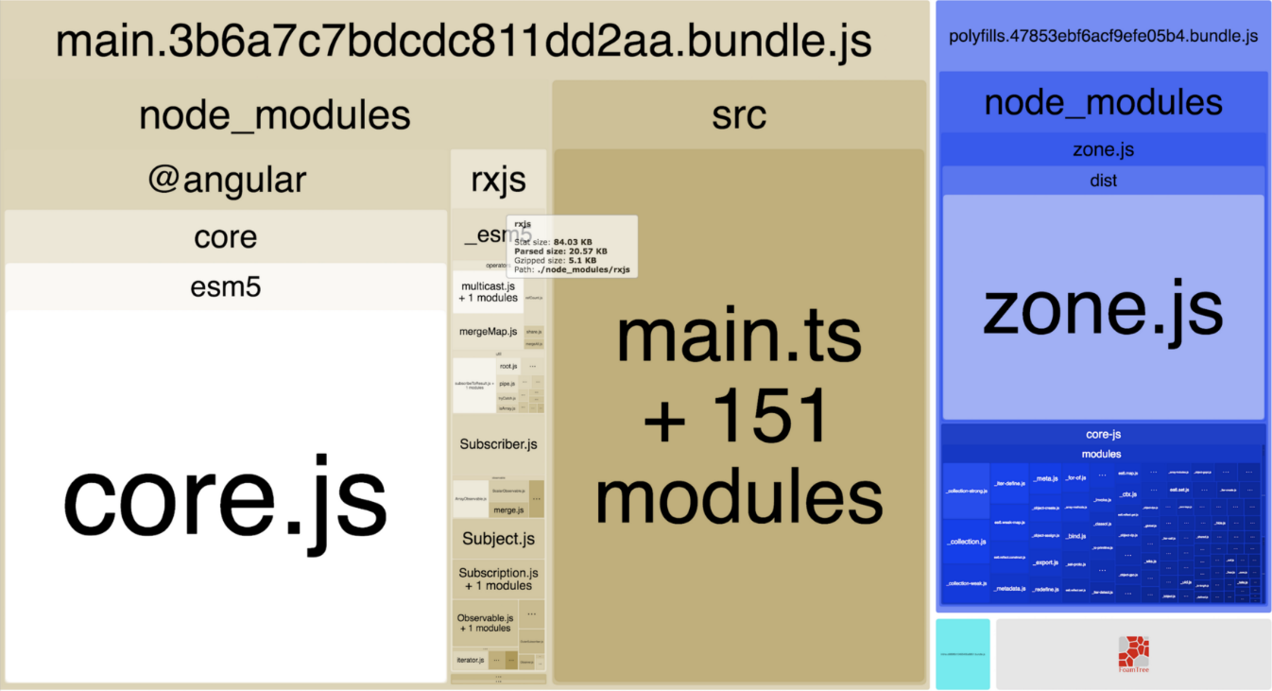
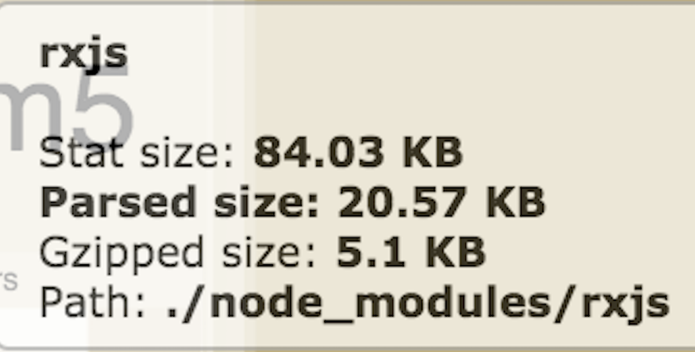
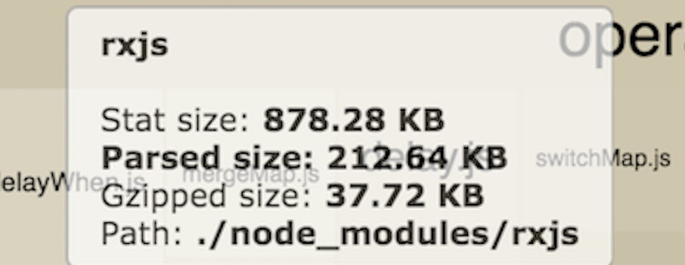
RxJS Tree Shaking

Slide 55
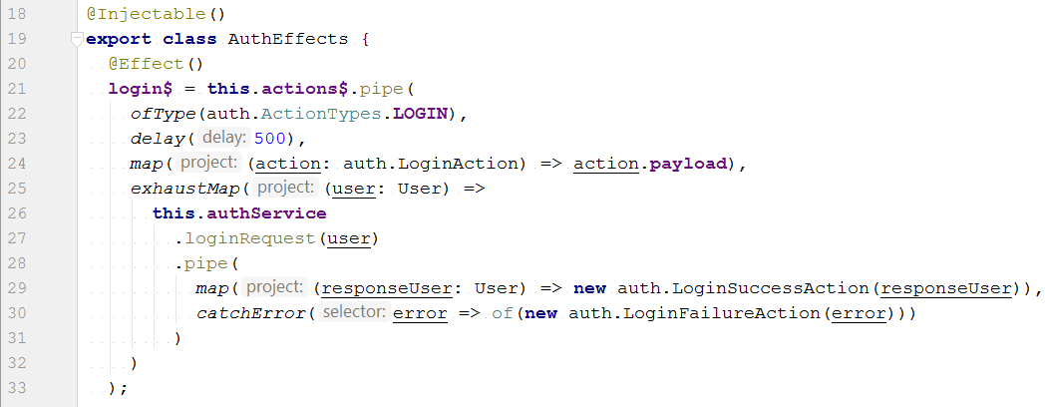
How does it look?

Slide 56
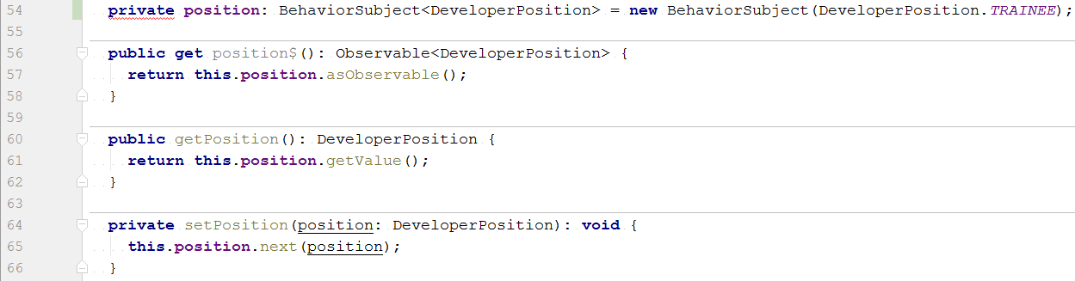
How does it look?

Slide 57
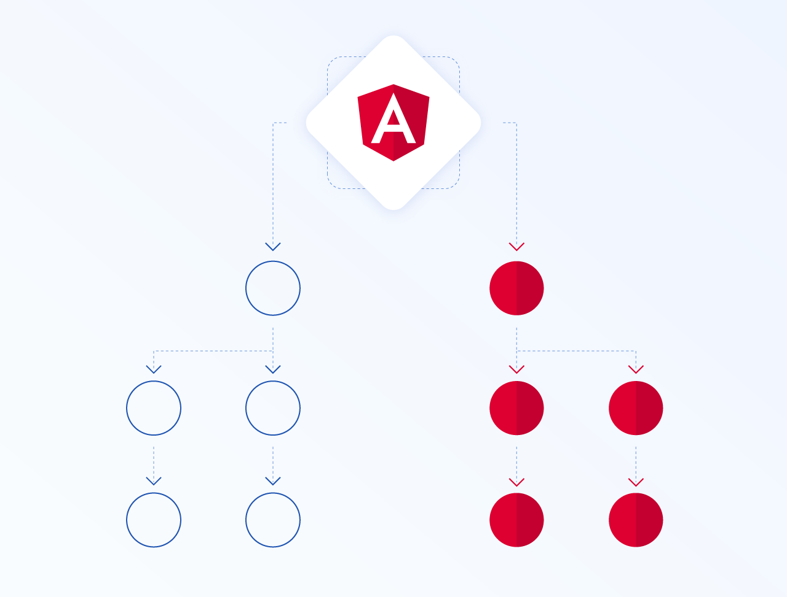
Combination with Angular and CD

Slide 58
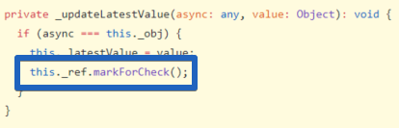
Combination with Angular and CD
https://github.com/angular/angular/blob/5.2.8/packages/common/src/pipes/async_pipe.ts#L43-L145
https://www.youtube.com/watch?v=CUxD91DWkGM
It helps to work with Angular ChangeDetection strategy

Slide 59
Additional features
Configuration – global project configuration for different types of environments, constants
Internationalization – multi language support
Utility – set of reusable helper functions and services
Shared components – shared and reusable project components and classes

Slide 60
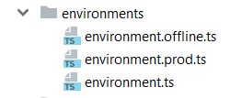
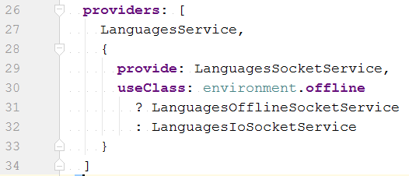
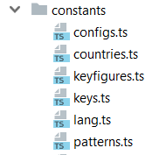
Additional features - configuration

Slide 61
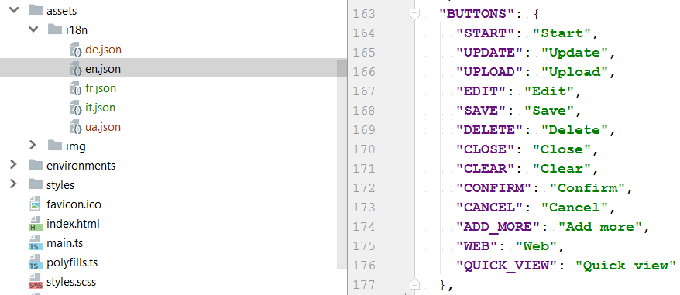
Additional features - internationalization

Slide 62
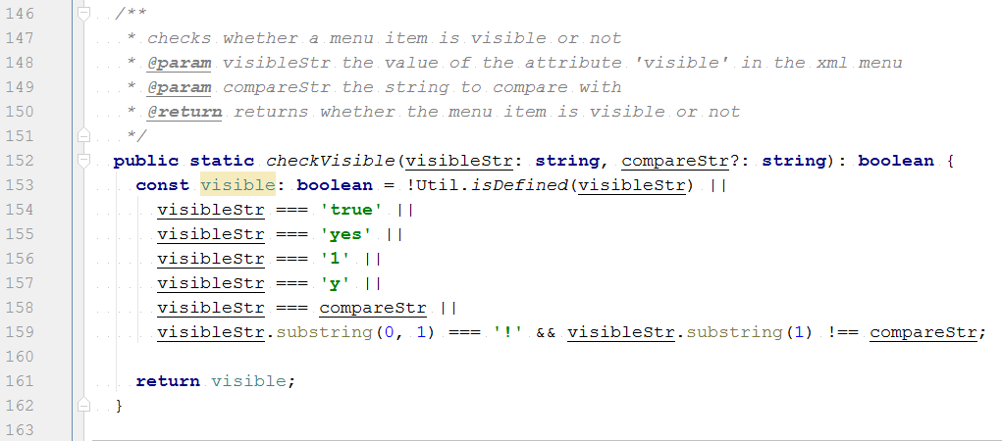
Additional features - utils

Slide 63

Make your team happy

Slide 64
Links to hold in mind
Angular Blogs
https://blog.angularindepth.com - Angular In Depth
https://netbasal.com – Netanel Basal
https://blog.nrwl.io – Nrwl Angular Consulting
https://blog.thoughtram.io – Thoughtram
https://toddmotto.com – Todd Motto
https://blog.angular.io – Angular Blog ☺ Cap
https://blog.angular-university.io – Angular University
https://blog.mgechev.com - Minko Gechev
Rxjs
Books
Conferences
If you need it I can add ☺ just tell me …

Slide 65

Questions & Answers

